Slide 1

Data Mining & Business Intelligence
Module 4:Clustering
Faculty Name: Ms.Reshma Gulwani, Ms.Ravita Mishra

Slide 2
Index -
Lecture 24 – Density Based Clustering | 4
Lecture 25 - Partitioning Method | 16
Lecture 26 –Hierarchical Clustering | 29
Lecture 27 –Density Based Methods | 52

Slide 3
Lecture 17
Density Based Clustering

Slide 4
DBSCAN
DBSCAN is a density-based algorithm.
DBSCAN requires two parameters: epsilon (Eps) and minimum points (MinPts).
It starts with an arbitrary starting point that has not been visited .
It then finds all the neighbour points within distance Eps of the starting point.
If the number of neighbours is greater than or equal to MinPts, a cluster is formed.
The starting point and its neighbours are added to this cluster and the starting point is marked as visited.
The algorithm then repeats the evaluation process for all the neighbours recursively.
Lecture 15 -Hierarchical Method

Slide 5
DBSCAN
If the number of neighbours is less than MinPts, the point is marked as noise.
If a cluster is fully expanded (all points within reach are visited) then the algorithm proceeds to iterate through the remaining unvisited points in the dataset.
Lecture 15 -Hierarchical Method

Slide 6
Major features:
Discover clusters of arbitrary shape
Handle noise
One scan
Need density parameters
Lecture 15 -Hierarchical Method

Slide 7
Basic concept:
For any cluster we have:
  A central point (p) i.e. core point
  A distance from the core point(Eps)
  Minimum number of points within the specified distance (MinPts)
Lecture 15 -Hierarchical Method

Slide 8
DBSCAN Algorithm
Create a graph whose nodes are the points to be clustered
For each core-point c create an edge from c to every point p in the -neighborhood of c
Set N to the nodes of the graph;
If N does not contain any core points terminate
Pick a core point c in N
Let X be the set of nodes that can be reached from c by going forward;
  a. create a cluster containing X∪∪{c}
  b. N=N/(X ∪∪ {c})
Continue with step 4
Lecture 15 -Hierarchical Method

Slide 9
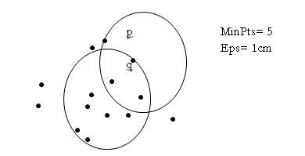
DBSCAN Algorithm
MinPts: Minimum number of points in any cluster
ϵϵ : For each point in cluster there must be another point in it less than this distance away.
-neighborhood: Points within  distance of appoint
N ϵϵ(p) :{q belongs to D |dist(p,q) <=ϵϵ)
Core point: ϵϵ- neighborhood dense enough (MinPts)
Conditions: p belongs to N ϵϵ(q)
|Nϵϵ(q)| > = MinPts
Lecture 15 -Hierarchical Method

Slide 10
Density-Based Clustering Methods
Clustering based on density (local cluster criterion), such as density-connected points or based on an explicitly constructed density function
Major features:
  Discover clusters of arbitrary shape
  Handle noise
  One scan
  Need density parameters
Several interesting studies:
  DBSCAN: Ester, et al. (KDD’96)
  DENCLUE: Hinneburg & D. Keim (KDD’98/2006)
  OPTICS: Ankerst, et al (SIGMOD’99).
  CLIQUE: Agrawal, et al. (SIGMOD’98)

Slide 11
Density-Based Clustering Methods
DBSCAN is a density-based algorithm.
  Density = number of points within a specified radius r (Eps)
  A point is a core point if it has more than a specified number of points (MinPts) within Eps
    These are points that are at the interior of a cluster
  A border point has fewer than MinPts within Eps, but is in the neighborhood of a core point
  A noise point is any point that is not a core point or a border point.

Slide 12

DBSCAN: Core, Border, and Noise Points

Slide 13
Lecture 17
Outliers

Slide 14
What are Outliers?
An Observation or subset of observation which is different from remaining set of data under analysis.
It can have unusually large or small values compared to the rest of data.
Outlier: A data object that deviates significantly from the normal objects as if it were generated by a different mechanism.
Outliers arise due to number of reasons, a few of them include instrumental error, Human mistakes, deviation in population, system behavioral changes or system faults.
Outliers are different from the noise data
  Noise is random error or variance in a measured variable
  Noise should be removed before outlier detection
  Outliers-Out of range data
  Noise-Null, Void data
Outliers are interesting: It violates the mechanism that generates the normal data

Slide 15

What are Outliers?
Outlier detection vs. novelty detection: early stage, outlier; but later merged into the model
Applications:
  Credit card fraud detection
  Telecom fraud detection
  Customer segmentation
  Medical analysis
Lecture 1-Knowledge of database, data warehouse, OLAP

Slide 16
Types of Outliers
Three kinds: global, contextual and collective outliers
Global outlier (or point anomaly)
When a data object considerably differs from rest of the given data set,
One of the simplest outlier.
Object is O_{g} if it significantly deviates from the rest of the data set
  Ex. Intrusion detection in computer networks
  Issue: Find an appropriate measurement of deviation
Global Outlier

Slide 17
Contextual outlier (or conditional outlier)(Conditional anomalies)
Object is O_{c} if it deviates significantly based on a selected context or its neighborhood.
Mostly in time series data.
Suppose it is winter season and suddenly temperature rises to 35 degree at some instance of time t1 on a day this could be considered as a contextual outlier.
Attributes of data objects should be divided into two groups
  Contextual attributes: defines the context, e.g., time & location
  Behavioral attributes: characteristics of the object, used in outlier evaluation, e.g., temperature
Lecture 1-Knowledge of database, data warehouse, OLAP

Slide 18

Collective Outliers
A subset of data objects when outlying with respect to entire data set,they are called as collective outlier.
The individual data objects in collective outliers are not outliers, but their occurrence together as a substructure considered to be an outlier.
These types of outliers are significant only when the data object have a sequential or spatial data.
Applications: E.g., intrusion detection:
When a number of computers keep sending denial-of-service packages to each other
Collective Outlier
Lecture 15 -Hierarchical Method

Slide 19
Collective Outliers
Detection of collective outliers
  Consider not only behavior of individual objects, but also that of groups of objects
  Need to have the background knowledge on the relationship among data objects, such as a distance or similarity measure on objects.
A data set may have multiple types of outlier
One object may belong to more than one type of outlier

Slide 20
Challenges of Outlier Detection
Modeling normal objects and outliers properly
  Hard to enumerate all possible normal behaviors in an application
  The border between normal and outlier objects is often a gray area
Application-specific outlier detection
  Choice of distance measure among objects and the model of relationship among objects are often application-dependent
  E.g., clinic data: a small deviation could be an outlier; while in marketing analysis, larger fluctuations

Slide 21
Challenges of Outlier Detection
Handling noise in outlier detection
  Noise may distort the normal objects and blur the distinction between normal objects and outliers. It may help hide outliers and reduce the effectiveness of outlier detection
Understandability
  Understand why these are outliers: Justification of the detection
  Specify the degree of an outlier: the unlikelihood of the object being generated by a normal mechanism

Slide 22
Outlier Detection I: Supervised Methods
Two ways to categorize outlier detection methods:
  Based on whether user-labeled examples of outliers can be obtained:
    Supervised, semi-supervised vs. unsupervised methods
  Based on assumptions about normal data and outliers:
    Statistical, proximity-based, and clustering-based methods

Slide 23
Outlier Detection I: Supervised Methods
Supervised anomaly detection techniques require a data set that has been labeled as "normal" and "abnormal" and involves training a classifier
Training data set has instances which are labeled as normal and outlier class.
Two Predictive models can be built up for both normal as well as outlier class.
As unseen data can then be compared against the two models to find out which class it belongs to normal or outlier.
One of the limitation –very expensive to get an accurate labeled training data as labeling method is manual and requires lot of human efforts.
Artificial outlier may also be injected into normal data and supervised outlier detection may be applied to detect outliers in test data
Lecture 1-Knowledge of database, data warehouse, OLAP

Slide 24
Outlier Detection II: Unsupervised Methods
Where the data is not labeled as a normal or outlier,
Assume the normal objects are somewhat ``clustered'‘ into multiple groups, each having some distinct features
An outlier is expected to be far away from any groups of normal objects
Weakness: Cannot detect collective outlier effectively
  Normal objects may not share any strong patterns, but the collective outliers may share high similarity in a small area
Ex. In some intrusion or virus detection, normal activities are diverse
  Unsupervised methods may have a high false positive rate but still miss many real outliers.
  Supervised methods can be more effective, e.g., identify attacking some key resources

Slide 25
Outlier Detection II: Unsupervised Methods
Many clustering methods can be adapted for unsupervised methods
  Find clusters, then outliers: not belonging to any cluster
  Problem 1: Hard to distinguish noise from outliers
  Problem 2: Costly since first clustering: but far less outliers than normal objects
    Newer methods: tackle outliers directly
Lecture 1-Knowledge of database, data warehouse, OLAP

Slide 26
Outlier Detection III: Semi-Supervised Methods
The data is labeled for only one type of class as it is difficult to get data for other class.
In Airline system fault detection, an outlier would be an accident which is not easy to model.
In this approach, the test instance which does not fit the model would be assumed to belong to other class.
Situation: In many applications, the number of labeled data is often small: Labels could be on outliers only, normal objects only, or both
Lecture 1-Knowledge of database, data warehouse, OLAP

Slide 27
Outlier Detection III: Semi-Supervised Methods
If only some labeled outliers are available, a small number of labeled outliers many not cover the possible outliers well
  To improve the quality of outlier detection, one can get help from models for normal objects learned from unsupervised methods

Slide 28
Outlier Detection (1): Statistical Methods
Statistical methods (also known as model-based methods) assume that the normal data follow some statistical model (a stochastic model)
  The data not following the model are outliers.
Example (right figure): First use Gaussian distribution to model the normal data
  For each object y in region R, estimate g_{D}(y), the probability of y fits the Gaussian distribution
  If g_{D}(y) is very low, y is unlikely generated by the Gaussian model, thus an outlier

Slide 29
Outlier Detection (1): Statistical Methods
Statistical approaches were the oldest algorithms used for outlier identification.
The statistical approach assumes that data follows some standard or predefined distribution or probability model, and aims to identify outliers with respect to the model using a discordance test (those outliers which do not follow such distributions).
A discordance test is used to detect whether a given object is an outlier or not.
The general idea behind statistical methods for outlier detection is to learn a generative model fitting the given data set, and then identify those objects in low probability regions of the model as outliers.
Statistical methods performs poorly on high dimensional data.
Lecture 1-Knowledge of database, data warehouse, OLAP

Slide 30
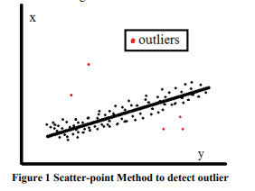
Outlier Detection (1): Statistical Methods
Statistical methods for outlier detection can be divided into two major categories:
Parametric methods Model using parametric technique grow only with model complexity not data size.
Assumes that the normal data objects are generated by a parametric distribution.
Regression, scatter-point method are popular parametric method. This figure shows scatter-point method to detecting outliers.
Lecture 1-Knowledge of database, data warehouse, OLAP

Slide 31
Outlier Detection (1): Statistical Methods
Nonparametric methods The model of normal data is learned from the input data, rather than assuming one a priori.
It do not make any assumption about statistical distribution of data.
Histogram, Kernel density function, Kernel feature space are methods of non-parametric techniques.
Lecture 1-Knowledge of database, data warehouse, OLAP

Slide 32
Outlier Detection (2): Proximity-Based Methods
Proximity-based approaches assume that the proximity of an outlier object to its nearest neighbors significantly deviates from the proximity of the object to most of the other objects in the data se
Example: Model the proximity of an object using its 3 nearest neighbors
  Objects in region R are substantially different from other objects in the data set.
  Thus the objects in R are outliers

Slide 33
Outlier Detection (2): Proximity-Based Methods
The effectiveness of proximity-based methods highly relies on the proximity measure.
In some applications, proximity or distance measures cannot be obtained easily.
Often have a difficulty in finding a group of outliers which stay close to each other
Two major types of proximity-based outlier detection
  Distance-based vs. density-based
Lecture 1-Knowledge of database, data warehouse, OLAP

Slide 34
Proximity-Based Approaches: Distance-Based vs. Density-Based Outlier Detection
Intuition: Objects that are far away from the others are outliers
Assumption of proximity-based approach: The proximity of an outlier deviates significantly from that of most of the others in the data set
Two types of proximity-based outlier detection methods
  Distance-based outlier detection: An object o is an outlier if its neighborhood does not have enough other points
  Density-based outlier detection: An object o is an outlier if its density is relatively much lower than that of its neighbors

Slide 35
Outlier Detection (3): Clustering-Based Methods
Normal data belong to large and dense clusters, whereas outliers belong to small or sparse clusters, or do not belong to any clusters
Example (right figure): two clusters
  All points not in R form a large cluster
  The two points in R form a tiny cluster, thus are outliers

Slide 36
Outlier Detection (3): Clustering-Based Methods
Since there are many clustering methods, there are many clustering-based outlier detection methods as well
Clustering is expensive: straightforward adaption of a clustering method for outlier detection can be costly and does not scale up well for large data sets
Lecture 1-Knowledge of database, data warehouse, OLAP

Slide 37
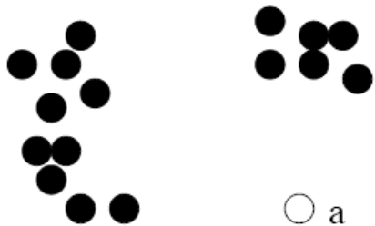
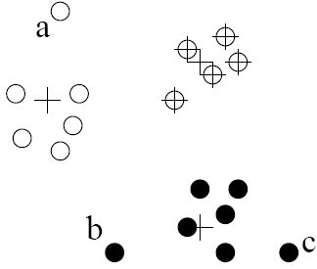
Clustering-Based Outlier Detection (1 & 2):
Not belong to any cluster, or far from the closest one
An object is an outlier if (1) it does not belong to any cluster, (2) there is a large distance between the object and its closest cluster , or (3) it belongs to a small or sparse cluster
Case I: Not belong to any cluster
  Identify animals not part of a flock: Using a density-based clustering method such as DBSCAN
Case 2: Far from its closest cluster
  Using k-means, partition data points of into clusters
  For each object o, assign an outlier score based on its distance from its closest center
    If dist(o, c_{o})/avg_dist(c_{o}) is large, likely an outlier
Ex. Intrusion detection: Consider the similarity between data points and the clusters in a training data set

Slide 38
Clustering-Based Outlier Detection (1 & 2):
Not belong to any cluster, or far from the closest one
  Use a training set to find patterns of “normal” data, e.g., frequent itemsets in each segment, and cluster similar connections into groups
  Compare new data points with the clusters mined—Outliers are possible attacks

Slide 39
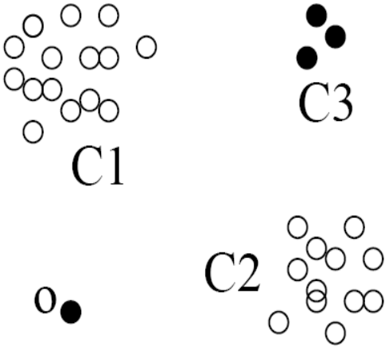
Clustering-Based Outlier Detection (3):
Detecting Outliers in Small Clusters
FindCBLOF: Detect outliers in small clusters
  Find clusters, and sort them in decreasing size
  To each data point, assign a cluster-based local outlier factor (CBLOF):
  If obj p belongs to a large cluster, CBLOF = cluster_size X similarity between p and cluster
  If p belongs to a small one, CBLOF = cluster size X similarity betw. p and the closest large cluster
Ex. In the figure, o is outlier since its closest large cluster is C₁, but the similarity between o and C₁ is small. For any point in C₃, its closest large cluster is C₂ but its similarity from C₂ is low, plus |C₃| = 3 is small

Slide 40
Clustering-Based Method: Strength and Weakness
Strength
  Detect outliers without requiring any labeled data
  Work for many types of data
  Clusters can be regarded as summaries of the data
  Once the cluster are obtained, need only compare any object against the clusters to determine whether it is an outlier (fast)
Weakness
  Effectiveness depends highly on the clustering method used—they may not be optimized for outlier detection
  High computational cost: Need to first find clusters
  A method to reduce the cost: Fixed-width clustering
    A point is assigned to a cluster if the center of the cluster is within a pre-defined distance threshold from the point
    If a point cannot be assigned to any existing cluster, a new cluster is created and the distance threshold may be learned from the training data under certain conditions

Slide 41
Statistical Approaches
Statistical approaches assume that the objects in a data set are generated by a stochastic process (a generative model)
Idea: learn a generative model fitting the given data set, and then identify the objects in low probability regions of the model as outliers
Methods are divided into two categories: parametric vs. non-parametric
Parametric method
  Assumes that the normal data is generated by a parametric distribution with parameter θ
  The probability density function of the parametric distribution f(x, θ) gives the probability that object x is generated by the distribution
  The smaller this value, the more likely x is an outlier
Non-parametric method
  Not assume an a-priori statistical model and determine the model from the input data
  Not completely parameter free but consider the number and nature of the parameters are flexible and not fixed in advance
  Examples: histogram and kernel density estimation

Slide 42




Parametric Methods I: Detection Univariate Outliers Based on Normal Distribution
Univariate data: A data set involving only one attribute or variable
Often assume that data are generated from a normal distribution, learn the parameters from the input data, and identify the points with low probability as outliers
Ex: Avg. temp.: {24.0, 28.9, 28.9, 29.0, 29.1, 29.1, 29.2, 29.2, 29.3, 29.4}
  Use the maximum likelihood method to estimate μ and σ
  Taking derivatives with respect to μ and σ², we derive the following maximum likelihood estimates
  For the above data with n = 10, we have
  Then (24 – 28.61) /1.51 = – 3.04 < –3, 24 is an outlier since

Slide 43
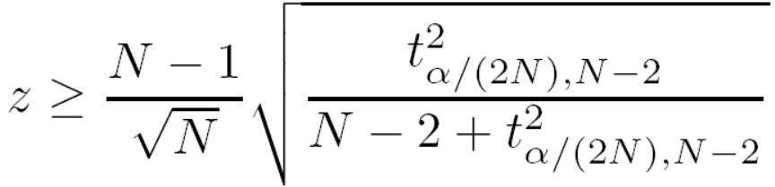

Parametric Methods I: The Grubb’s Test
Univariate outlier detection: The Grubb's test (maximum normed residual test) ─ another statistical method under normal distribution
  For each object x in a data set, compute its z-score: x is an outlier if
    where is the value taken by a t-distribution at a significance level of α/(2N), and N is the # of objects in the data set

Slide 44

Parametric Methods II: Detection of Multivariate Outliers
Multivariate data: A data set involving two or more attributes or variables
Transform the multivariate outlier detection task into a univariate outlier detection problem
Method 1. Compute Mahalaobis distance
  Let ō be the mean vector for a multivariate data set. Mahalaobis distance for an object o to ō is MDist(o, ō) = (o – ō )^{T} S ^{–1}(o – ō) where S is the covariance matrix
  Use the Grubb's test on this measure to detect outliers
Method 2. Use χ² –statistic:
  where E_{i} is the mean of the i-dimension among all objects, and n is the dimensionality
  If χ² –statistic is large, then object o_{i} is an outlier

Slide 45
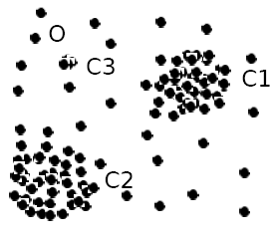
Parametric Methods III: Using Mixture of Parametric Distributions
Assuming data generated by a normal distribution could be sometimes overly simplified
Example (right figure): The objects between the two clusters cannot be captured as outliers since they are close to the estimated mean
To overcome this problem, assume the normal data is generated by two normal distributions. For any object o in the data set, the probability that o is generated by the mixture of the two distributions is given by
  where f_{θ1} and f_{θ2} are the probability density functions of θ₁ and θ₂
Then use EM algorithm to learn the parameters μ₁, σ₁, μ₂, σ₂ from data
An object o is an outlier if it does not belong to any cluster

Slide 46
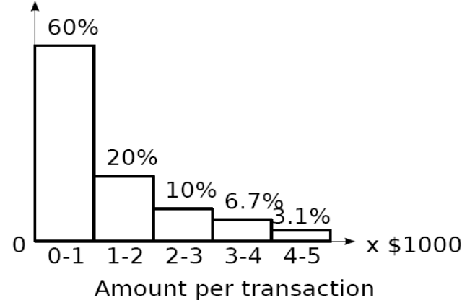
Non-Parametric Methods: Detection Using Histogram
The model of normal data is learned from the input data without any a priori structure.
Often makes fewer assumptions about the data, and thus can be applicable in more scenarios
Outlier detection using histogram:
  Figure shows the histogram of purchase amounts in transactions
  A transaction in the amount of $7,500 is an outlier, since only 0.2% transactions have an amount higher than $5,000
Problem: Hard to choose an appropriate bin size for histogram
  Too small bin size → normal objects in empty/rare bins, false positive
  Too big bin size → outliers in some frequent bins, false negative
Solution: Adopt kernel density estimation to estimate the probability density distribution of the data. If the estimated density function is high, the object is likely normal. Otherwise, it is likely an outlier.

Slide 47
Chapter 12. Outlier Analysis
Outlier and Outlier Analysis
Outlier Detection Methods
Statistical Approaches
Proximity-Base Approaches
Clustering-Base Approaches
Classification Approaches
Mining Contextual and Collective Outliers
Outlier Detection in High Dimensional Data
Summary

Slide 48
Proximity-Based Approaches: Distance-Based vs. Density-Based Outlier Detection
Intuition: Objects that are far away from the others are outliers
Assumption of proximity-based approach: The proximity of an outlier deviates significantly from that of most of the others in the data set
Two types of proximity-based outlier detection methods
  Distance-based outlier detection: An object o is an outlier if its neighborhood does not have enough other points
  Density-based outlier detection: An object o is an outlier if its density is relatively much lower than that of its neighbors

Slide 49
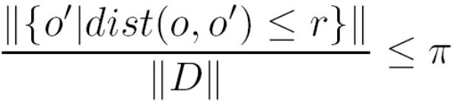

Distance-Based Outlier Detection
For each object o, examine the # of other objects in the r-neighborhood of o, where r is a user-specified distance threshold
An object o is an outlier if most (taking π as a fraction threshold) of the objects in D are far away from o, i.e., not in the r-neighborhood of o
An object o is a DB(r, π) outlier if
Equivalently, one can check the distance between o and its k-th nearest neighbor o_{k}, where . o is an outlier if dist(o, o_{k}) > r
Efficient computation: Nested loop algorithm
  For any object o_{i}, calculate its distance from other objects, and count the # of other objects in the r-neighborhood.
  If π∙n other objects are within r distance, terminate the inner loop
  Otherwise, o_{i} is a DB(r, π) outlier
Efficiency: Actually CPU time is not O(n²) but linear to the data set size since for most non-outlier objects, the inner loop terminates early

Slide 50
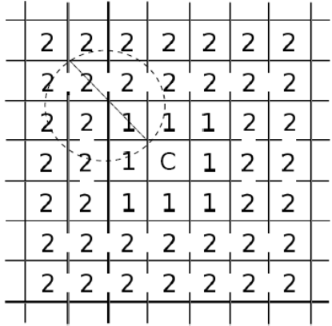
Distance-Based Outlier Detection: A Grid-Based Method
Why efficiency is still a concern? When the complete set of objects cannot be held into main memory, cost I/O swapping
The major cost: (1) each object tests against the whole data set, why not only its close neighbor? (2) check objects one by one, why not group by group?
Grid-based method (CELL): Data space is partitioned into a multi-D grid. Each cell is a hyper cube with diagonal length r/2
Pruning using the level-1 & level 2 cell properties:
  For any possible point x in cell C and any possible point y in a level-1 cell, dist(x,y) ≤ r
  For any possible point x in cell C and any point y such that dist(x,y) ≥ r, y is in a level-2 cell
Thus we only need to check the objects that cannot be pruned, and even for such an object o, only need to compute the distance between o and the objects in the level-2 cells (since beyond level-2, the distance from o is more than r)

Slide 51
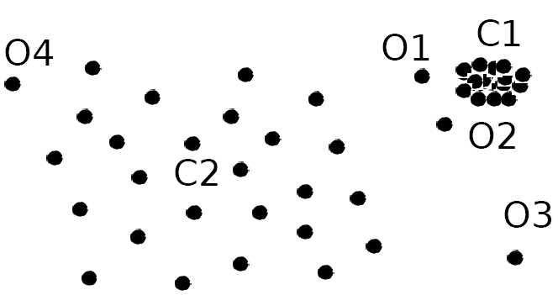
Density-Based Outlier Detection
Local outliers: Outliers comparing to their local neighborhoods, instead of the global data distribution
In Fig., o₁ and o2 are local outliers to C₁, o₃ is a global outlier, but o₄ is not an outlier. However, proximity-based clustering cannot find o₁ and o₂ are outlier (e.g., comparing with O₄).
Intuition (density-based outlier detection): The density around an outlier object is significantly different from the density around its neighbors
Method: Use the relative density of an object against its neighbors as the indicator of the degree of the object being outliers
k-distance of an object o, dist_{k}(o): distance between o and its k-th NN
k-distance neighborhood of o, N_{k}(o) = {o’| o’ in D, dist(o, o’) ≤ dist_{k}(o)}
  N_{k}(o) could be bigger than k since multiple objects may have identical distance to o

